Slide 1

Digital Champions in Adult Social Care
Welcome session 03 March 2025

Slide 2
Purpose of group
Purpose: This group is designed to bring together digital champions in social care to share knowledge, enhance skills, and support each other in utilising digital tools effectively.
Goals: Our main goals are to improve digital literacy, foster a supportive community, and ensure everyone feels confident using digital resources in their roles.

Slide 3

Agenda
Welcome and introductions
Icebreaker activity
Overview of Skills for Care training
Q&A session
Next steps and closing remarks

Slide 4
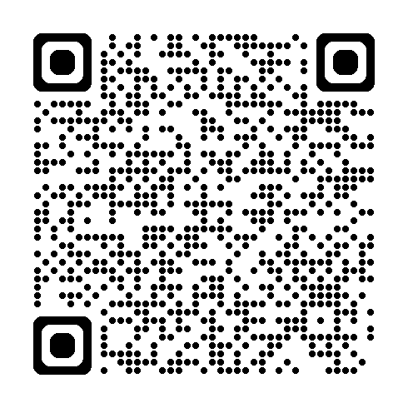
Want to share a fun fact?
https://app.sli.do/event/uhte8n5NfTrqyPShHgzyj2

Slide 5
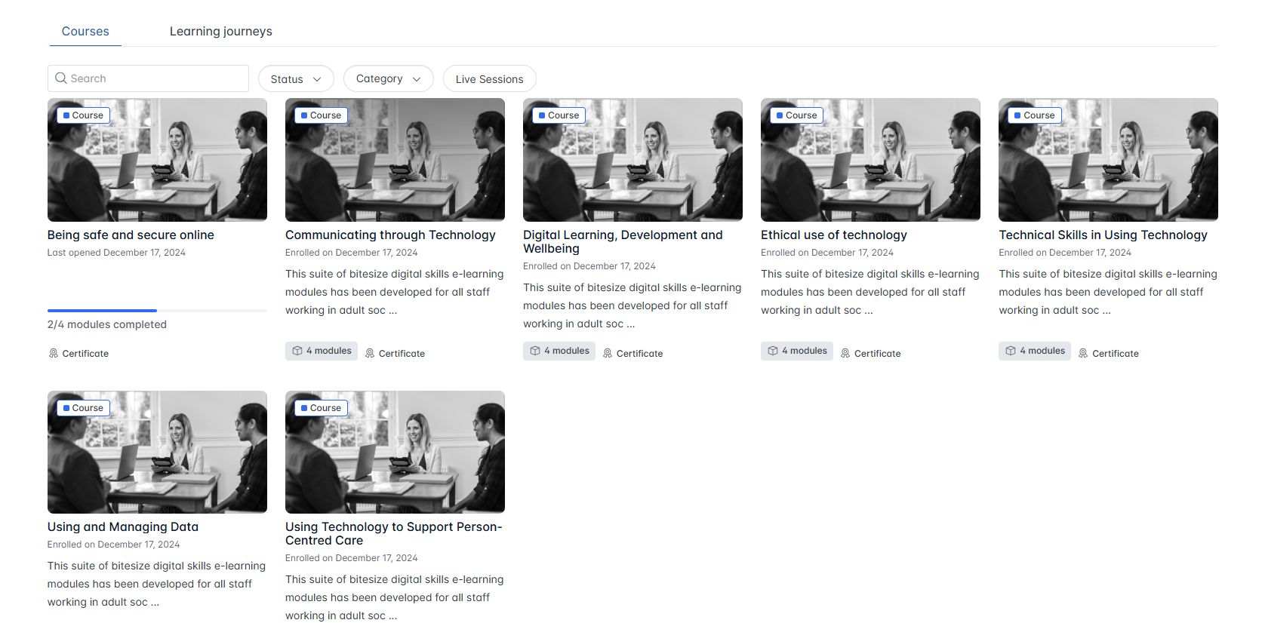
Skills for Care training
Accessible via Log in | skillsforcare

Slide 6
Skills for Care training
Have you started any of the modules?
Initial thoughts?

Slide 7
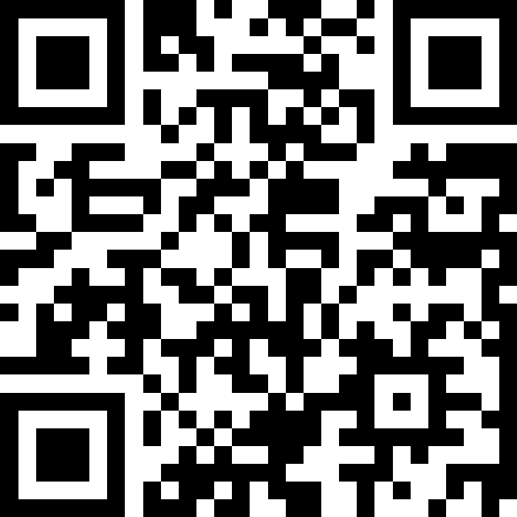
What topic are you most excited about
https://app.sli.do/event/uhte8n5NfTrqyPShHgzyj2

Slide 8
Moving Forward
Sessions will take place every 4-6 weeks
Booking via Eventbrite
Sessions will focus on helping you complete the Skills for Care training
We will also be using feedback and discussion from each session to shape the following one
alexandros.gavriilidis@dorsetcouncil.gov.uk Strategic Commissioning Lead – Project Lead DiSC
hannah.lloyd@dorsetcouncil.gov.uk & Digitaldorset@dorsetcouncil.gov.uk Project Manager, Dorset Council.
juddm@bpc.ac.uk Mel Judd, Lead Project Officer, Partners in Care

